Slide 1
Data infrastructure to create the future we want Or How can we be better ancestors?
Copyright Centre for Digital Built Britain, on behalf of the Chancellor, Masters and Scholars of the University of Cambridge, 2021. All Rights Reserved.

Slide 2
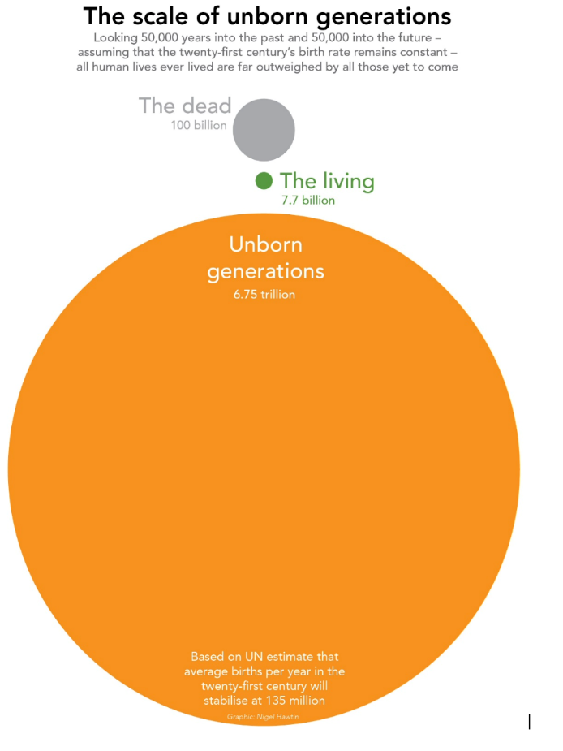
© Tony Fish 2021

Slide 3
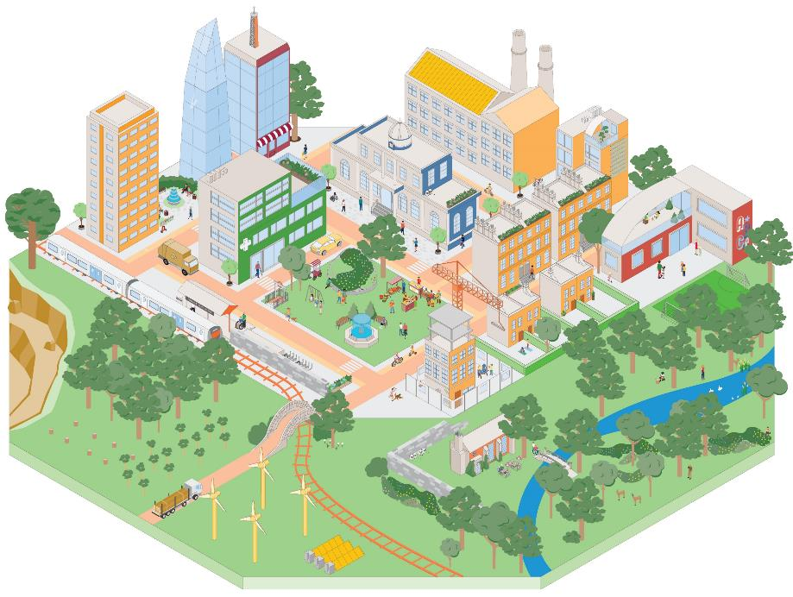
The Vision
Our Vision is for a built environment whose explicit purpose is to enable people and nature to flourish together for generations
It is only when we shift our focus from creating the built environment to the outcomes enabled by it that people and nature can thrive together for the generations to come
The built and natural environments are complex and interconnected systems that are essential for our wellbeing
Improving outcomes for people and nature depends on the services that these systems provide and on coordinating the built environment as a whole, not just as individual parts

Slide 4
Why now
The built environment is too big to ignore
The greatest challenges of our generation are systemic and interdependent
The pandemic has emphasised important realities:
Wellbeing is crucial
Decisions have long-term consequences
Change can happen quickly
We need to get more from less

Slide 5
Why now - Choices in the built environment can last for generations

Slide 6
The built environment as a system of systems
Copyright Centre for Digital Built Britain, on behalf of the Chancellor, Masters and Scholars of the University of Cambridge, 2021. All Rights Reserved.

Slide 7
Services - the connection between the outcomes we desire and the systems we use to achieve them

Slide 8
Cyber-physical system
Data
Interventions
Copyright Centre for Digital Built Britain, on behalf of the Chancellor, Masters and Scholars of the University of Cambridge, 2021. All Rights Reserved.

Slide 9
This is digital built Britain
Design
Use best practice, secure by default, information management and digital techniques to get data right from the start and design better-performing homes, buildings and infrastructure.
Build
Exploit new and emerging
digital construction, information management, and manufacturing technologies to improve safety, quality and production during construction.
Operate
Use effective information management to transform the performance of the built environment and the services it delivers.
Integrate
Understand how the built environment can improve citizen’s quality of life and use that information
to drive the design and build of our economic and social infrastructure and the operation an integration of the services they deliver.
Copyright Centre for Digital Built Britain, on behalf of the Chancellor, Masters and Scholars of the University of Cambridge, 2021. All Rights Reserved.

Slide 10
Digital twins
Physical
Twin
Data
Digital
Twin
Insights
Outcomes
Interventions
Decisions
Copyright Centre for Digital Built Britain, on behalf of the Chancellor, Masters and Scholars of the University of Cambridge, 2021. All Rights Reserved.

Slide 11
Digital twins
Delivering value: “better decisions faster”
Assets
Processes
Systems
Physical
Twin
Data
Digital
Twin
Data
Models
Visualisation
Interventions
Driven by values: purpose, trust and function
Copyright Centre for Digital Built Britain, on behalf of the Chancellor, Masters and Scholars of the University of Cambridge, 2021. All Rights Reserved.

Slide 12
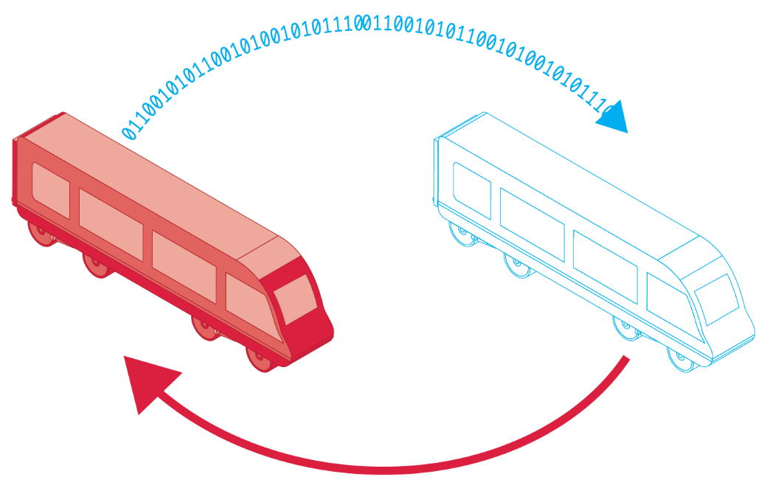
Digital twins
Data
Physical twin
Insights
Decisions
Outcomes
Digital twin
Interventions
Copyright Centre for Digital Built Britain, on behalf of the Chancellor, Masters and Scholars of the University of Cambridge, 2021. All Rights Reserved.

Slide 13
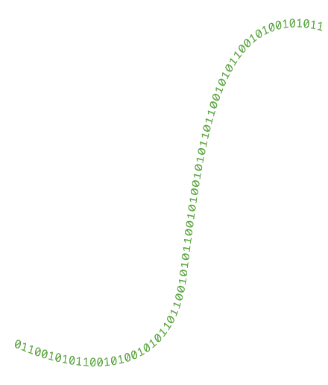
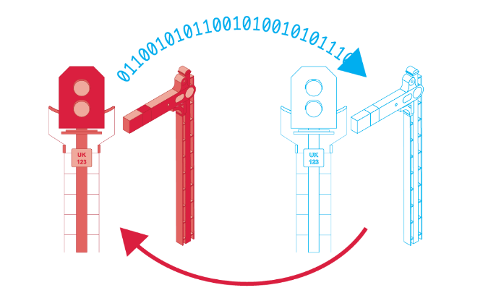
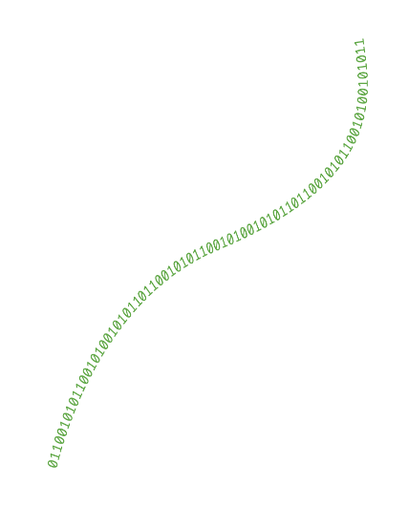
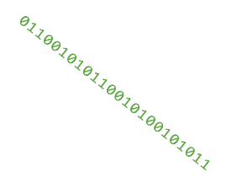
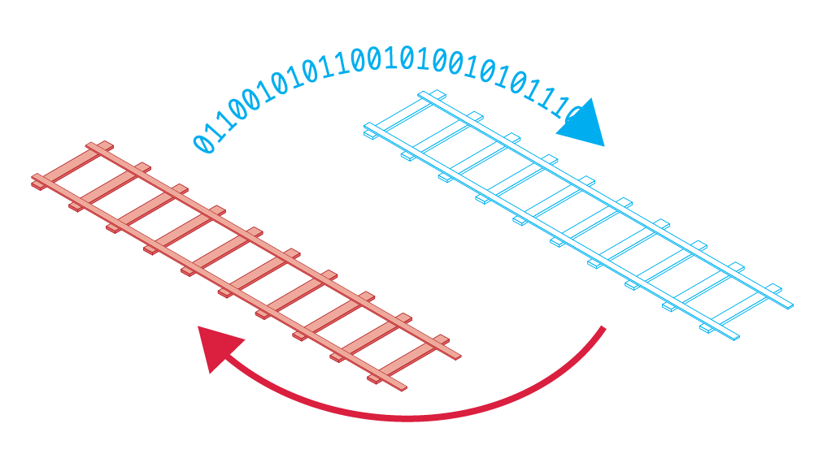
Connected digital twins
Copyright Centre for Digital Built Britain, on behalf of the Chancellor, Masters and Scholars of the University of Cambridge, 2021. All Rights Reserved.

Slide 14
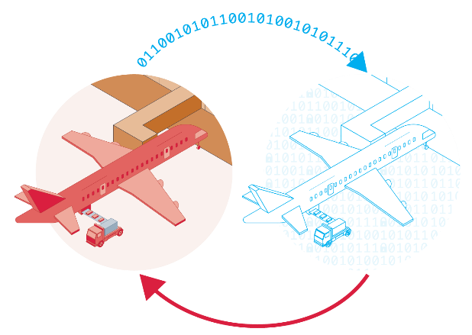
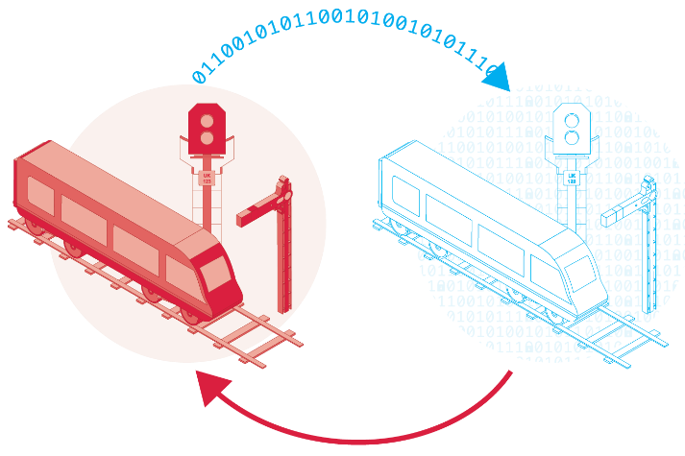
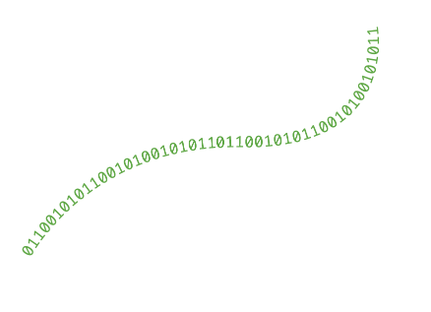
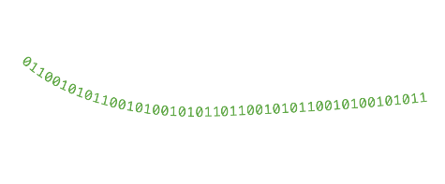
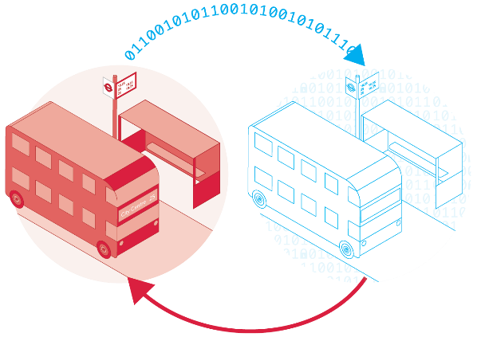
Ecosystem of connected digital twins
Copyright Centre for Digital Built Britain, on behalf of the Chancellor, Masters and Scholars of the University of Cambridge, 2021. All Rights Reserved.

Slide 15
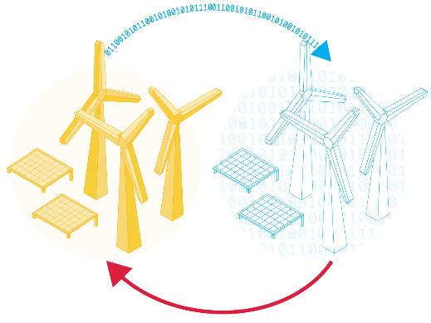
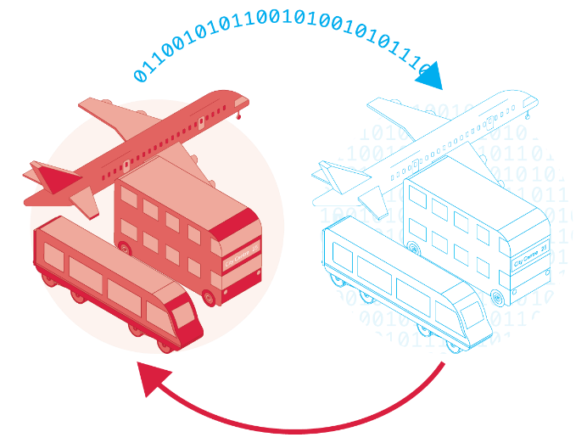
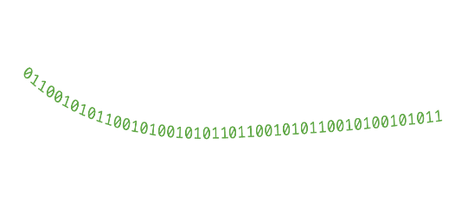
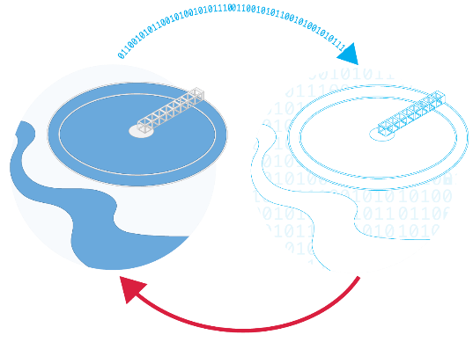
Ecosystem of connected digital twins
Copyright Centre for Digital Built Britain, on behalf of the Chancellor, Masters and Scholars of the University of Cambridge, 2021. All Rights Reserved.

Slide 16
The pathway towards an Information Management Framework
Foundation Data Model – a consistent, clear understanding of what constitutes the world of digital twins
Reference Data Library – the particular set of classes and the properties we will want to use to describe our digital twins
Integration Architecture – the protocols that will enable the managed sharing of data
Copyright Centre for Digital Built Britain, on behalf of the Chancellor, Masters and Scholars of the University of Cambridge, 2021. All Rights Reserved.

Slide 17
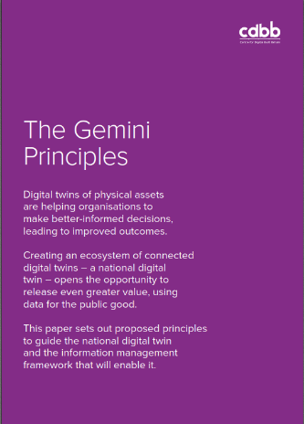
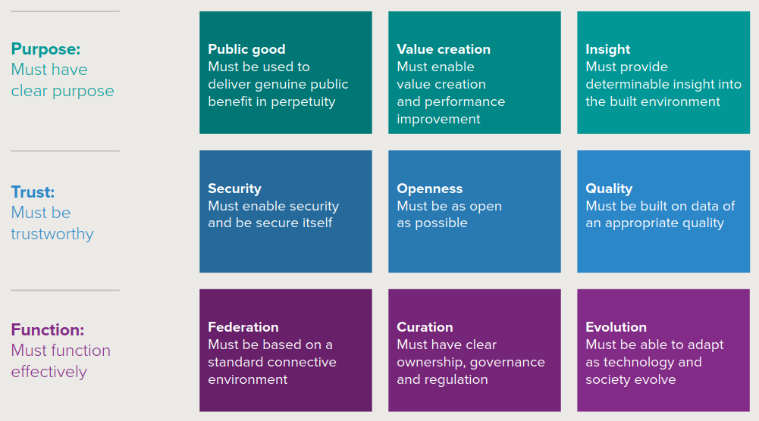
Driven by values
Copyright Centre for Digital Built Britain, on behalf of the Chancellor, Masters and Scholars of the University of Cambridge, 2021. All Rights Reserved.

Slide 18
A NDTp has to be a socio-technical change programme
Socio-
Technical
Copyright Centre for Digital Built Britain, on behalf of the Chancellor, Masters and Scholars of the University of Cambridge, 2021. All Rights Reserved.

Slide 19
Benefits of a National Digital Twin
Better decisions equal better outcomes for people and society
Benefits to society: Improved stakeholder engagement. Better outcomes for the ultimate customers (the public – taxpayers/bill payers/fare payers/voters). Improved customer satisfaction and experience through higher-performing infrastructure and the services it provides.
Benefits to the economy: Improved national productivity from higher-performing and resilient infrastructure operating as a system. Improved measurement of outcomes. Better outcomes per whole-life pound. Improved information security and thereby personnel, physical and cyber security.
Benefits to business: New markets, new services, new business models, new entrants. Improved business efficiency from higher-performing infrastructure. Improved delivery efficiency, benefiting the whole construction value chain – investors, owners, asset managers, contractors, consultants, suppliers. Reduced uncertainty and better risk management.
Benefits to the environment: Less disruption and waste. More reuse and greater resource efficiency – a key enabler of net zero and the circular economy in the built environment.
Copyright Centre for Digital Built Britain, on behalf of the Chancellor, Masters and Scholars of the University of Cambridge, 2021. All Rights Reserved.

Slide 20
The planet is ultimate system of systems
We can make Our Vision a reality, but only if we all play our part with energy, coordination and purpose, making use of the advanced array of enablers that we now have at our disposal.

Slide 21
Thank you Build better connections: digitaltwinhub.co.uk
Copyright Centre for Digital Built Britain, on behalf of the Chancellor, Masters and Scholars of the University of Cambridge, 2021. All Rights Reserved.

