Slide 1
The DT Hub
Progression through collective innovation

Slide 2
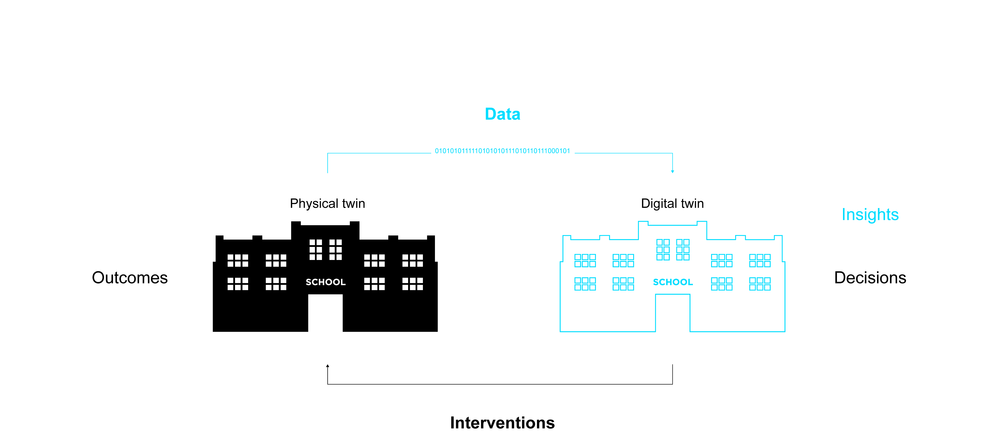
Where it all began…
Notes:
– The use of digital twins is on the rise not just in the UK, but globally.
– Digital twins are the digital representations of physical assets. Simply put, they’re the opportunity for companies to test and forecast on their assets before committing to making actual changes.
– This means companies can save money, time and resources by using digital twins

Slide 3
The nation’s digital twins
Energy
Telecoms
Transport
Waste
Social
infrastructures
Water
Residential
infrastructures
Natural
environment
Notes:
– Use cases – Construction companies saving time and money being able to ‘construct’ in the digital form first to check for any potential faults/challenges
Utilities saving time and money, and improving public relations, when having to cause disruption with planned engineering works
Transport companies being able to develop better contingency plans when disruption occur

Slide 4
Bringing together
Notes:
– There is huge potential to be explored with the use of a digital twin, but we are thinking much bigger than just the one…

Slide 5
Bringing together
Benefits
Agility
Cost saving
Time saving
Supporting innovation
Reliability
Adaptability
Positive environmental impact
Notes:
– We know, from use cases with BIM and smart infrastructure that there is great value in data when it’s shared.
– From a commercial standpoint, the benefits of developing a National Digital Twin are (but are not limited to)
Growing new career, business and export opportunities
Security-minded information management
Exploit new and emerging digital twin technology and techniques
Opportunity to improve our nation’s infrastructure in such as way as to create a global precedent.
Improved safety, quality and productivity of digital twins, and their physical assets through access to best practice framework and principles

Slide 6
What is the National Digital Twin programme?
2017
2018
2020
2030
2040
HM Government
CDBB
NDT
programme
DT Hub
IMF
National Digital Twin
Notes:
– With the benefit potential for the use of a single digital twin being so inspiring, we can’t help but envision what the collective potential would be if the nation’s digital twins operated within a shared ecosystem.
– The transformative potential of digital twins lies in connecting them together, providing greater insight through wider context.
– It’s this visionary and innovative thinking that was the foundation for the development of the world’s first ever National Digital Twin Programme
– Launched by HM Treasury in July 2018, the Centre for Digital Built Britain (CDBB’s) National Digital Twin programme was set up to deliver key recommendations of the National Infrastructure Commission 2017 ”Data for the Public Good Report”
– CDBB’s vision for the national digital twin is an ecosystem of connected digital twins that have evolved with shared vision and values.
– Our government-backed National Digital Twin Programme guides and enables UK-wide industry to collectively develop and apply best practices for creating integrable digital twins. Connecting twins at a national-level will improve lives, strengthen our economy, and have a lasting positive effect on the environment that will serve future generations also.

Slide 7
What’s happened so far?
Notes:
– Since the National Digital Twin Programme was launched back in July 2018, we’ve been busy putting the necessary foundations into place to help inform and guide the collaborative development of the NDT.
– The technology already exists to enable this programme, what it needs is the methodology to drive it.

Slide 8
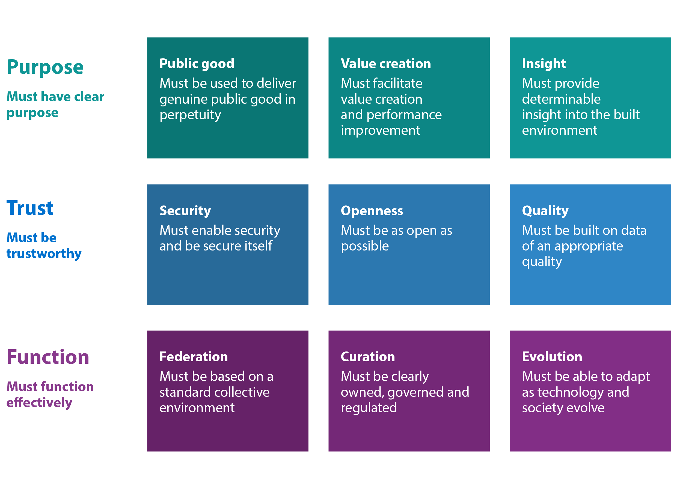
Gemini Principles
Notes:
– GEMINI PRINCIPLES – In collaboration with stakeholders spanning government, industry and academia we developed the founding set of definitions and values that are applicable to any area of industry, but create consensus in the development of digital twins, enabling the National Digital Twin to take shape.
– The basis of these values is that all digital twins must have clear purpose, must be trustworthy and must function effectively. They are deliberately simple, but their implications are far-reaching and challenging. They are descriptive of intent, but agnostic on solutions, to encourage innovation and development over time.

Slide 9
Gemini Principles
Information Management Framework
Notes:
– IMF – In addition to this we have commenced work on developing a national-level framework which will set the standards and provide support for the management of information within the national digital twin. For this, We’re inviting the UK’s leading information management experts to collaborate on developing the framework by which national, and future global digital twins will operate.

Slide 10
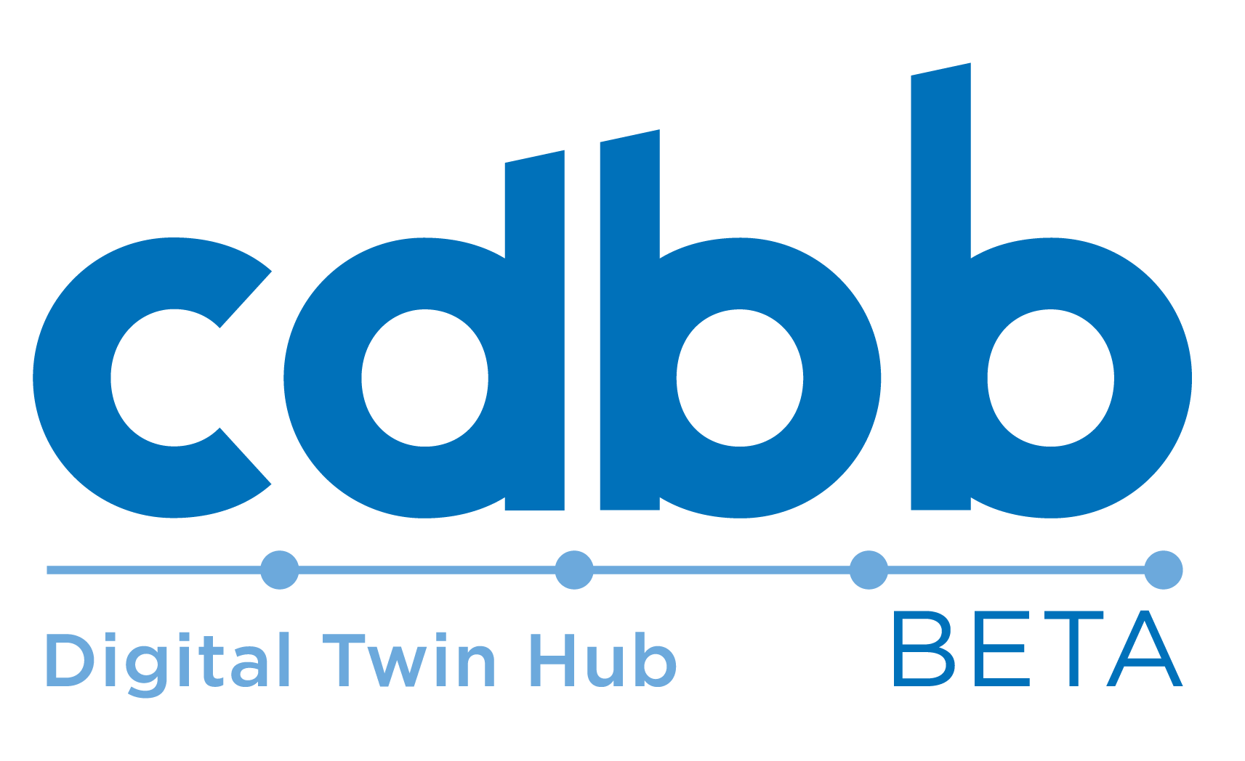
Gemini Principles
Information Management Framework
DT Hub
Notes:
– Finally, we’ve created the DT Hub, which is what we’re going to focus on in this presentation…

Slide 11
Bringing together
Notes:
In order for this programme to be a success, we need to introduce as many organisations as possible that currently sit outside the immediate built environment infrastructure, yet influence it still, to ensure we gain the most value.
Bringing these organisations together, to collaborate and cooperate with each other, and with the existing economic, social and environmental factors is the objective and the ambition of the DT Hub.

Slide 12
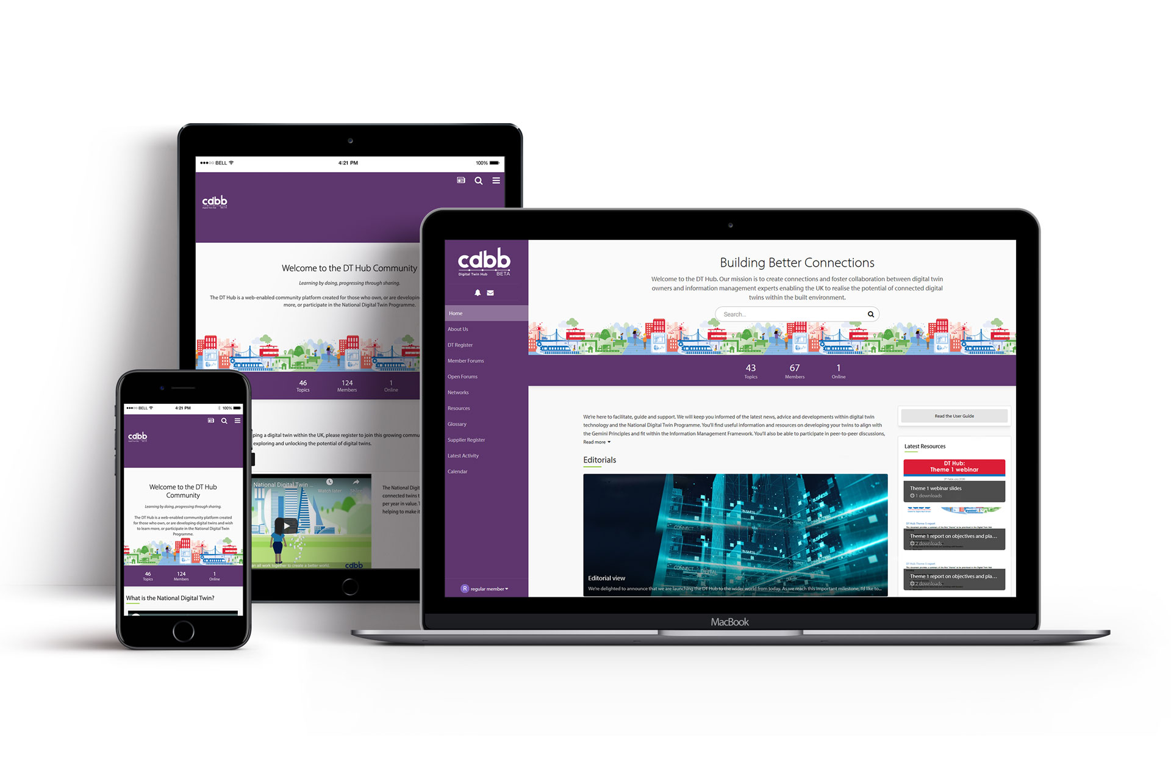
What is the DT Hub?
The DT Hub is a web-enabled community platform created for those who own, or are developing digital twins and wish to learn more, or participate in the National Digital Twin programme
Notes:
– The DT Hub is a web-enabled community platform created for those who own, or are developing digital twins and wish to learn more, or participate in the
National Digital Twin programme.
– It’s been designed to enable digital twin owners/developers and information management experts to collaborate and share knowledge.
– A network created for the purposes of learning and sharing knowledge that will inform/build the Information Management Framework
– Principally the role of the DT Hub is to guide the community to resolve challenges, and to foster innovation.

Slide 13
What are the objectives of the DT Hub?
Collaborate
Innovate
Guide
Encourage collective learning and sharing experiences on digital twins
Encourage and enable the development of expertise and the advancement of digital twin usage
Steer the development of best practice and offer guidance on data sharing and digital twins
Champion
Connect
Support
To highlight and promote the benefits of digital twins and present case studies
Provide a register of digital twins and connect those involved in the field
Provide support and guidance on the adoption of the Gemini Principles and Information Management Framework
Enable
Use the connected data insight of the National Digital Twin to empower smarter decision making for generations to come
Notes:
COLLABORATE – Encourage collective learning and sharing experiences on digital twins
INNOVATE – Encourage and enable the development of expertise and the advancement of digital twin usage
GUIDE Steer the development of best practice and offer guidance on data sharing and digital twins
CHAMPION – To highlight and promote the benefits of digital twins and present case studies
NETWORK – Provide a register of digital twins and connect those involved in the field
SUPPORT – Provide support and guidance on the adoption of the Gemini Principles and Information Management Framework
And finally, to EMPOWER – Use the connected data insight of the National Digital Twin to empower smarter decision making for generations to come

Slide 14
What are the short term vs long term goals?
Milestone 4
Testing change on targeted stakeholders in order to elicit challenges
and blockers
Milestone 1
Engage 50+ leading UK organisations to join DT Hub
Milestone 2
Share learning from DT Hub, pilots and demonstrators
Milestone 3
Identify & manage technology enablers and blockers
Milestone 5
Engage 75+ leading UK organisations to join DT Hub
Milestone 6
Develop common standards and methodologies
Notes:
– The DT Hub is here to take the community on a journey
– It’s a long journey we’ve embarked upon and one that will take time and effort to both navigate and travel.
– To enable us to bring everyone along with us, we need to focus on key milestones along the way as opposed to only seeing the ‘glittering unicorn’ at the end of the road, which in this instance is a National Digital Twin that delivers a more efficient, cost-effective and sustainable national infrastructure. Not a mutated horse!

Slide 15
The sum of our parts
Contribution, ideas and knowledge sharing
Diverse voices from across the sector
Gain the greatest potential from our digital twins
Notes:
– The strength and success of the DT Hub will depend entirely upon the contribution of those involved in it. The Hub welcomes and encourages the knowledge, ideas and experiences of those within the sector who are driven by shared values, innovation and curiosity.
– The more diverse voices we have contribute and collaborate from across the sector the more resources for insight, ideas, case
studies and informed discussions there will be.
– Given the range of services within the built environment the more experts, users and developers we can involve the richer the ideas pool for how best to utilise and adapt digital twins to the evolving industry and gain the greatest potential from them.

Slide 16
Who is it for?
DT Hub
Digital twin users
Digital twin owners and suppliers
Academics
Policy makers
Notes:
– The DT Hub is a space for members to collaborate that provides support and guidance for developing digital twins that are integrable with the NDT, therefore it is an ideal space for anyone looking to explore the potential of digital twin technology and share their ideas and experiences.
– This is most relevant for those who own, or are involved in the development of digital twins, within the UK along with national policy makers and academics involved in the study of information management.

Slide 17
Founding members
Notes:
– The DT Hub officially launched at the end of March 2020, and before that time it had already generated a great level of interest.
– 450+ organisations had already signed up – They have contributed a great deal of value to the programme to date helping to establish the Gemini Principles and the foundations of the IMF.
– What we need now is to welcome the second wave of members on board. This group of progressors will help to create real momentum for the programme by providing further insight and experience and opinions to enrich the community.

Slide 18
What’s in it for everyone?
Benefits
Influence
Reputation as progressor
Latest news/developments
New thinking
Access to expert/peer network
Support and guidance for best practice
Notes:
– There are many benefits we can identify to becoming a member of the DT Hub, some of which include:
Access to expert and peer networks providing opportunities to collaborate with other leading information management experts
Access to resources that include the latest news and developments within the world of digital twins
Opportunity to influence the creation of global standards for digital twins through collaboratively developing the IMF
Introduction to new ideas and new ways of thinking from collective knowledge and experiences of the network
Support and guidance on best practice measures for developing twins
The opportunity to be seen as a global leader in tech innovation
– The greatest benefit of all however, is likely to be that as the community grows and our collective experience and insight expands the benefits to be gained will grow exponentially

Slide 19
How and when to get involved
Visit digitaltwinhub.co.uk
Click ‘Register Interest Now’
We will be in touch with further information.
Notes:
– The pace of interest in joining the hub has been overwhelming. The appetite for getting involved is extremely encouraging, but as the facilitator of the community the hub needs to manage the growth in such a way that it’s sustainable and maintains the standard of quality.
– At this stage, we have our first wave members on board who have provided a huge value to the community and the programme to date. We’re now looking to attract further members and would encourage anyone who’s keen to be involved to register on the DT Hub website and we’ll be in touch with further information.
– Thank you and we look forward to working together.

