Slide 1
What is a digital built Britain?
Notes:
What is a digital built Britain?
A Digital Built Britain harnesses wealth of data being created by digital construction, high performing assets, smart cities, digital economy and connected citizens to deliver a Britain that is fit for the future
It will be achieved through changing the way we design, build, operate and integrate our physical, social and economic infrastructure.

Slide 2
Design
Deploy digital techniques to design better performing buildings, homes and infrastructure
Use good practice, secure by default, information management to get data right from the start
Notes:
Design
This means getting data requirements right from the start, using good practice, secure by default information management
It will also require looking at how advances in machine learning and artificial intelligence can improve the design of our homes, buildings and infrastructure

Slide 3
Design
Build
Exploit new and emerging digital construction and manufacturing technologies and techniques
Secure, shared information, enabling clients, design teams, construction teams and the supply chain to work more closely together to improve safety, quality and productivity during construction
Notes:
Build
We will exploit new and emerging digital construction and manufacturing techniques, such as robotics, off-site manufacturing and sub-assembly.
Secure, shared information, enabling clients, design teams, construction teams and the supply chain to work more closely together to improve safety, quality and productivity during construction

Slide 4
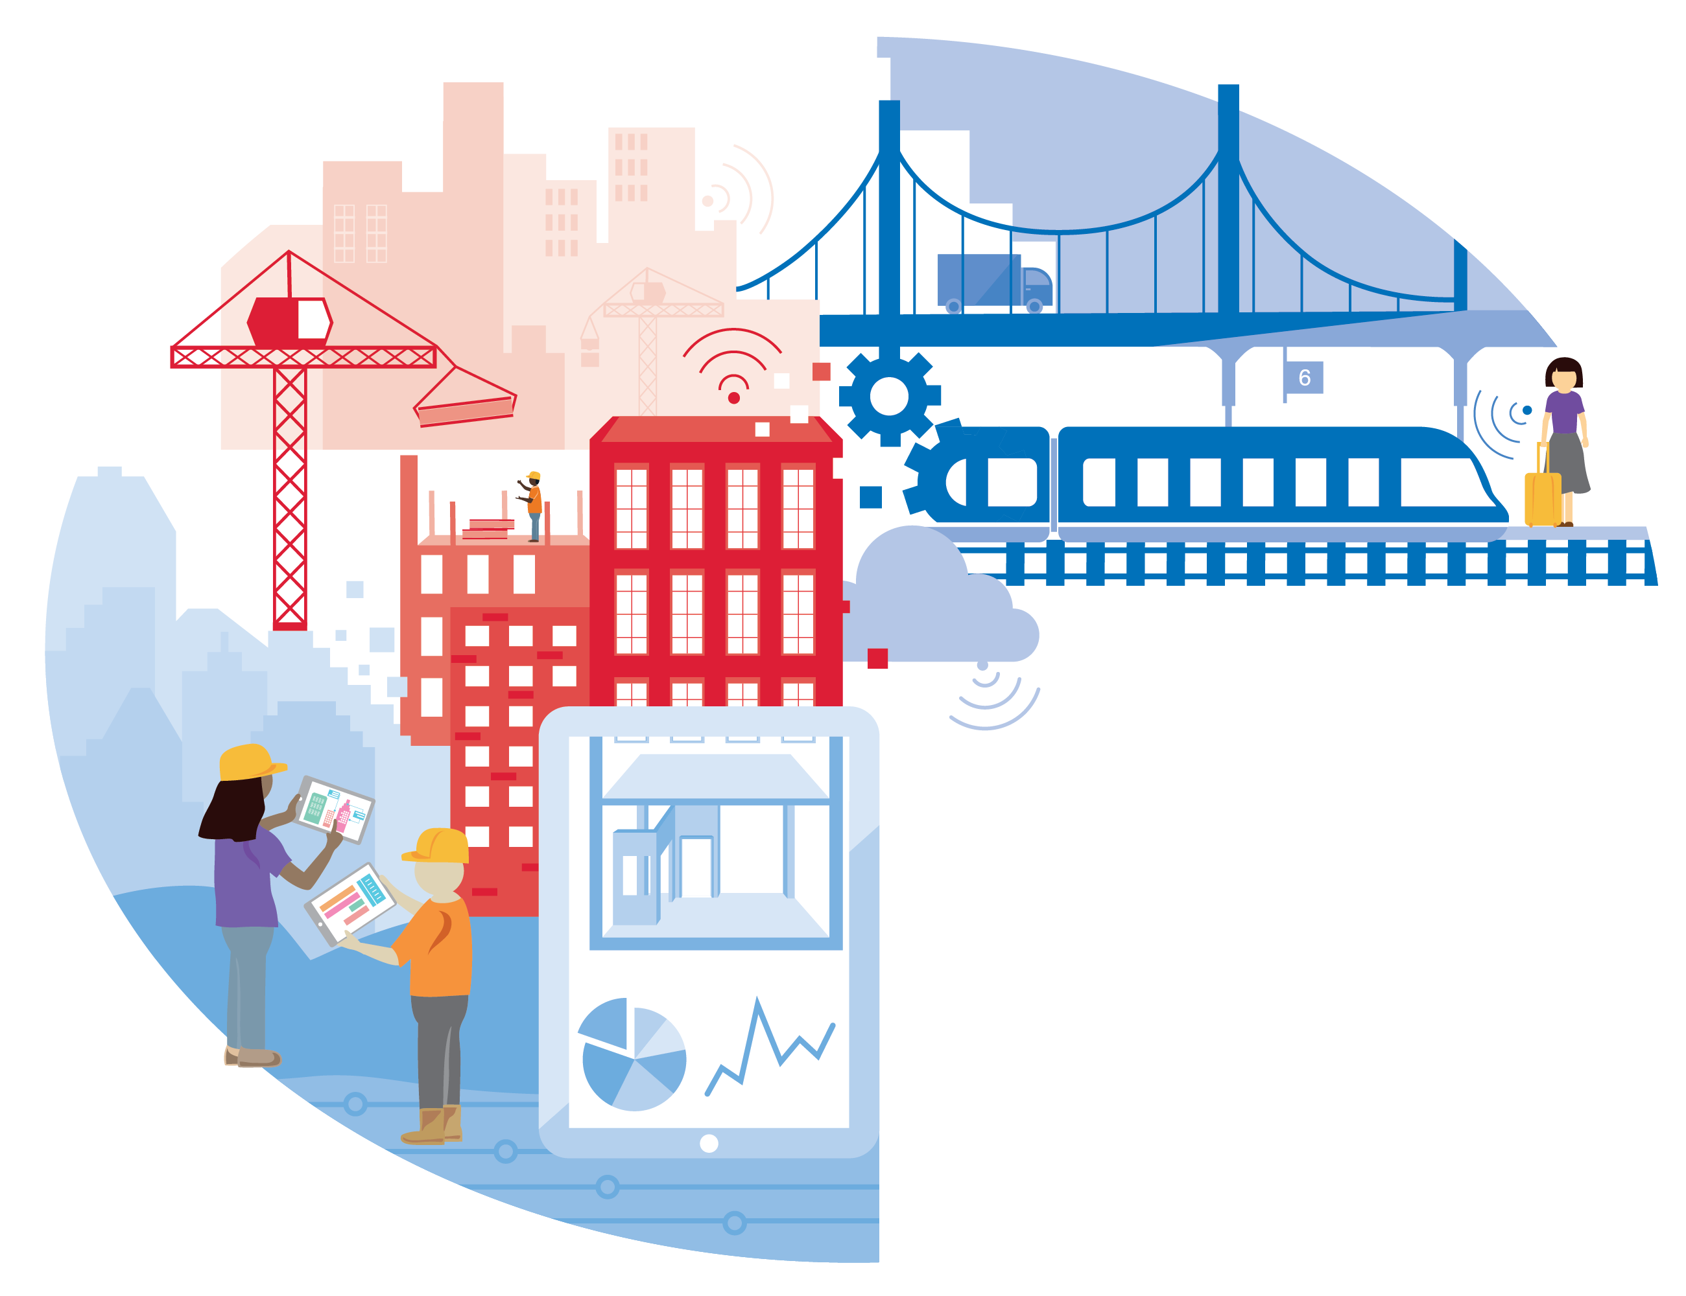
Design
Build
Operate
Use real time information to transform the performance of the built environment and its social and economic infrastructure
Smart asset management to predict and avoid disruption of services
Digitising existing assets
Notes:
Operate
Use real time information from the abundance of internet of things devices and sensor technology to transform the performance of the built environment and its social and economic infrastructure
We will use technology to find innovative ways of delivering more capacity out of our existing social and economic infrastructure, dramatically improving the way these assets deliver social services to deliver improved capacity and better public services

Slide 5
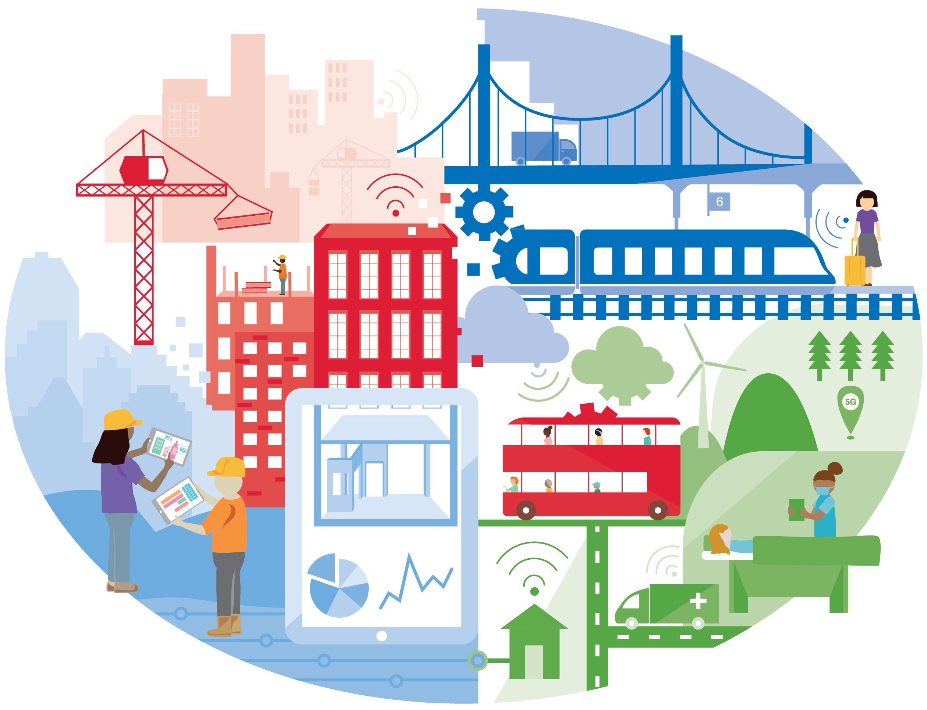
Design
Build
Operate
Integrate
understand how spaces and services can improve citizen quality of life
feed that information into the design and build of our economic and social infrastructure and the operation and integration of services they deliver
Notes:
Integrate
This is about understanding how spaces and services can improve citizen quality of life and using that information to improve how we design, build and operate our built environment

Slide 6
Design
Build
Operate
Integrate
A digital built Britain:
understanding what information is needed right from the start
ensuring feedback loops are in place throughout an asset’s lifecycle
information enabling better whole life value and optimising services to improve socio-economic outcomes for citizens
exploit new and emerging skills and technology to increase productivity.
Notes:
A digital built Britain
A digital built Britain should ultimately improve citizen quality of life and wellbeing by:
understanding what information is needed right from the start
ensuring feedback loops are in place throughout an asset’s lifecycle
information enabling better whole life value and optimising services to improve socio-economic outcomes
and exploiting new and emerging skills and technology to increase productivity.
Our ability to efficiently, effectively and cleanly design, build, operate and integrate the built environment is fundamental to the country’s economy and social wellbeing.
It is recognised that the increasing adoption and use of digital and offsite manufacturing technologies will have a vital role to play in achieving this.
Success is also reliant on being able to embed more transparent, open ways of working, as well as the sharing and use of large amounts of digital data and information.
We have now evolved the CDBB programme to better align, collaborate and innovate towards a digital built Britain.

