Slide 1
Digital Framework Task Group

Slide 2
Data for the public good
Recommendations:
A National Digital Twin – enabling digital twins to come together to help plan, predict and understand our assets
A Digital Framework – for effective information management; secure interoperability of data (the Framework)
A Digital Framework Task Group – to provide coordination of key players
Notes:
Title: Data for the Public Good
Published by: National Infrastructure Commission (NIC)
Date: December 2017
General Summary
Data for the Public Good sets a plan towards embedding smart infrastructure in national assets over a longitudinal time horizon of 10-30 years, and to develop a digital framework towards effective data and information management and sharing and a roadmap towards a national digital twin.
Impact of improved data sharing:
Lower consumer bills – greater efficiencies and lower operating costs
Reduced impact on environment – smart meters to reduce energy usage, avoid site visits and reduce carbon emissions
Improved transport – less time in traffic and fewer delays
Smart cities can become a reality – faster implementation of Internet of Things, driverless cars and other new technologies

Slide 3
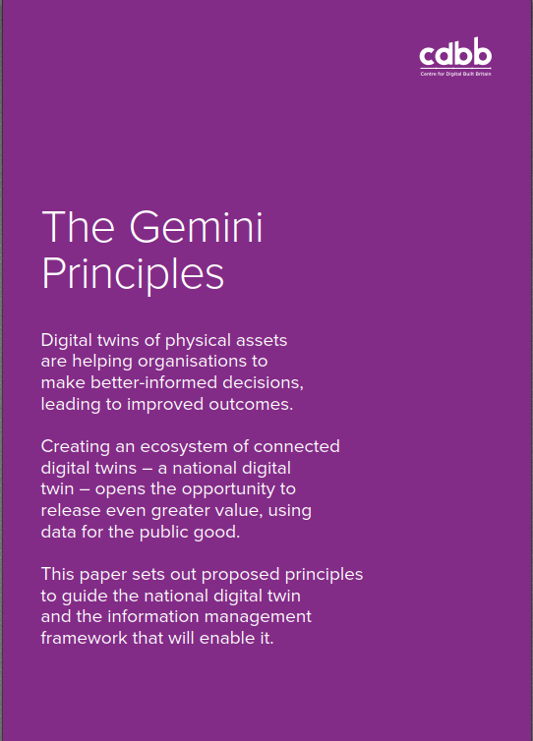
National Digital Twin
The National Digital Twin (NDT) is an ecosystem of DTs connected via securely shared data
A Digital Twin (DT) is a realistic digital representation of something physical
Notes:
What distinguishes a digital twin from any other digital model is its connection to the physical twin. Based on data from the physical asset or system, a digital twin unlocks value principally by supporting improved decision making, which creates the opportunity for positive feedback into the physical twin.
For example:
Digital Twin 1: a dynamic model of an asset, with input of current performance data from the physical twin via live data flows from sensors; feedback into the physical twin via real-time control.
Digital Twin 2: A static strategic planning model of a system, with input of long-term condition data from the physical twin via corporate systems; feedback into the physical twin via the capital investment process.

Slide 4
Digital Framework Task Group (DFTG): Purpose
to steer and guide the successful development and adoption of the Information Management Framework for the Built Environment (the ‘Framework’), which is to be set up by the CDBB
Notes:
The DFTG has four main objectives:
Alignment – to bring together key players in the industry to work towards a common purpose
Support – to support the development of a roadmap towards a National Digital Twin and to develop standards in the development of digital twins, constituting a framework
Engagement – to foster industry engagement in a framework and to cultivate a shift towards the minimum levels of the confidentiality of data
Regulation – to work with UK regulators and government to review and strengthen the role of economic regulators in improving the quality and openness of infrastructure data.

Slide 5
The Framework
The Information Management Framework for the built environment
provides all the necessary building blocks to enable effective information management across the built environment
enables secure, resilient data sharing
is the basis for the National Digital Twin
Notes:
The information management framework is intended to establish the necessary building blocks to enable effective information management across the built environment. This includes the secure data sharing that is fundamental for enabling the national digital twin.
The framework will support the creation of an ecosystem of connected digital twins across the built environment.
By complying with the framework, built environment data will be potentially sharable, but it will not necessarily be shared. Date will be shared only when it delivers value and it is appropriate and safe to do so.

Slide 6
Τhe Framework: vision
Effective information management will enable better decisions, leading to financial savings, improved performance and service, and better outcomes for business and society per whole-life pound.
To make this possible an information management framework is necessary in order to enable effective management of information that is fundamental for the creation of the national digital twin.
Simply put, it is about having the right information (and information that is right) for the right people at the right time.
Notes:
The framework will support the creation of an ecosystem of connected digital twins across the built environment.
By complying with the framework, built environment data will be potentially sharable, but it will not necessarily be shared. Date will be shared only when it delivers value and it is appropriate and safe to do so.

Slide 7
National Digital Twin: Enablers
Gemini Principles
Guiding values: the ‘conscience’ of the framework
Information management framework
Effective information management across the built environment, including secure data sharing
Roadmap
The prioritised plan for delivering the framework
Notes:
There are two key inputs to the Information Management Framework:
The Gemini Principles are the guiding values for the framework and the National Digital Twin.
The Roadmap is the prioritized plan that shows the best route for delivering the information management framework
Developing the framework is a substantial challenge, requiring a number of big questions to be addressed and industry alignment with the answers.
The roadmap has been broken down into five interconnected streams to make the challenge manageable:
Approach – what is the best overall approach for realizing the benefits of information management across the build environment?
Governance – what are the best structures and processes for managing the development, adoption and ongoing oversight of the framework?
Standardisation – what principles, guidance, specification and formal standards are required?
Enablers – what potential blockers are there, and how should they be addressed? What cultural, behavioural, technological, commercial or other adjustments are necessary?
Chane – what should be done to get the framework adopted across the whole of the built environment?

Slide 8
Guiding values: the Gemini Principles
By building consensus on foundational definitions and guiding values, alignment on the approach to information management across the built environment will be enabled.
Notes:
In order to make this change happen, we need strong founding principles that guide the development of a digital built Britain and to bring about alignment across the built environment, including the establishment of agreed definitions and values from the outset will make it easier for the industry to share data later.
The vision for Digital Built Britain is to enhance the natural an built environment, thereby driving up commercial competitiveness and productivity as well as quality of life and wellbeing for the public. This will be achieved through better planning, delivery and whole-life management of infrastructure and the wider built environment.

Slide 9
Values: the Gemini Principles
Public good
Value creation
Insight
Purpose
Security
Openness
Quality
Trust
Federation
Curation
Evolution
Function
Notes:
The Gemini Principles cut across all five streams of the roadmap.
The resulting principles fall into three overarching categories:
1) Purpose – Each part of the NDT and the framework must have a clear purpose.
The high-level purpose of the NDT is to help to improve the outcomes per whole-life pound (economic, social, environmental, safety and security outcomes), so each part should have clear and transparent purpose.
For this, the NDT will need an ongoing and growing evidence base to substantiate it.
The constituent digital twins will have many subsidiary purposes that contribute to the shared purposes of the NDT. The should have clear statements of purpose that are disseminated among stakeholders.
2) Trust – the national digital twin must be trustworthy.
Public trust in the national digital twin is very important. Loss of public trust would constitute a serious loss of value.
The NDT must be “ethical by design” and the governance and regulatory arrangements for overseeing it must be transparent, open and effective in ensuring that its operation is consistent with the Gemini Principles.
The framework and NDT must comply with the UK Data Ethics Framework.
The NDT must also be trustworthy for the owners of the constituent digital twins so that they feel confident to contribute. This is essential for the NDT to work effectively. Therefore, issues of liability and risk must be addressed in the NDT.
3) Function – the NDT must function effectively in support of its purpose and it must be available to users when required.
Effective information and security management is essential for the functioning of the NDT to be trustworthy.
Secure interoperability of master data sets is the key enabler of the NDT; this will need focus to make the NDT function.
A library of stakeholder co-produced and validated use cases should be developed to demonstrate the range of possible functions to other adopters.
Next steps
The next steps for the DFTG are:
Develop a roadmap for delivering the framework – has just been completed and will be published imminently.
Lead the co-development of the framework
Connect the leaders who are developing digital twins
The next steps for leaders involved in planning, creating and managing the built environment are to:
Build consensus of the Gemini Principles
Co-develop and implement the framework
Develop digital twins that comply with the Gemini Principles

Slide 10
Values: the Gemini Principles
Public good
Must be used to deliver genuine public benefit in perpetuity
Value creation Must enable value creation and performance improvement
Insight
Must provide determinable insight into the built environment
Purpose: Must have clear purpose
Security
Must enable security and be secure itself
Openness
Must be as open as possible
Quality
Must be built on data of an appropriate quality
Trust: Must be trustworthy
Federation
Must be based on a standard connected environment
Curation
Must have clear ownership, governance and regulation
Evolution
Must be able to adapt as technology and society evolve
Function: Must function effectively
Notes:
The Gemini Principles cut across all five streams of the roadmap.
The resulting principles fall into three overarching categories:
1) Purpose – Each part of the NDT and the framework must have a clear purpose.
The high-level purpose of the NDT is to help to improve the outcomes per whole-life pound (economic, social, environmental, safety and security outcomes), so each part should have clear and transparent purpose.
For this, the NDT will need an ongoing and growing evidence base to substantiate it.
The constituent digital twins will have many subsidiary purposes that contribute to the shared purposes of the NDT. The should have clear statements of purpose that are disseminated among stakeholders.
2) Trust – the national digital twin must be trustworthy.
Public trust in the national digital twin is very important. Loss of public trust would constitute a serious loss of value.
The NDT must be “ethical by design” and the governance and regulatory arrangements for overseeing it must be transparent, open and effective in ensuring that its operation is consistent with the Gemini Principles.
The framework and NDT must comply with the UK Data Ethics Framework.
The NDT must also be trustworthy for the owners of the constituent digital twins so that they feel confident to contribute. This is essential for the NDT to work effectively. Therefore, issues of liability and risk must be addressed in the NDT.
3) Function – the NDT must function effectively in support of its purpose and it must be available to users when required.
Effective information and security management is essential for the functioning of the NDT to be trustworthy.
Secure interoperability of master data sets is the key enabler of the NDT; this will need focus to make the NDT function.
A library of stakeholder co-produced and validated use cases should be developed to demonstrate the range of possible functions to other adopters.
Next steps
The next steps for the DFTG are:
Develop a roadmap for delivering the framework – has just been completed and will be published imminently.
Lead the co-development of the framework
Connect the leaders who are developing digital twins
The next steps for leaders involved in planning, creating and managing the built environment are to:
Build consensus of the Gemini Principles
Co-develop and implement the framework
Develop digital twins that comply with the Gemini Principles

Slide 11
NIC ‘Data for the public good’ Roadmap
The roadmap shows the prioritised route for delivering the
information management framework for the built environment

Slide 12
Data for the public good
Recommendation 1b:
1. The Government should task the Centre for Digital Built Britain (CDBB) with the establishment of a digital framework for infrastructure data, drawing together key organisations and existing initiatives both large scale(BIM) and smaller scale:
b. CDBB should set out a roadmap to a digital framework to develop standards and formats for collating and sharing data.

Slide 13
The Roadmap: core streams
Approach – To define the overall approach for delivering the benefits of effective information management across the built environment
Governance – To establish the structures and processes for managing the development, adoption and ongoing oversight of the framework
Commons – To develop the necessary support for effective information management via guidance, specifications and standards
Enablers – To identify and address the relevant potential blockers
Change – To facilitate adoption of the framework across the whole ecosystem of the built environment
Approach
Governance
The Commons
Enablers
Change

Slide 14
The Roadmap
Vision
3
Approach
Governance
3
3
2
Commons
2
3
1
2
3
1
Enablers
1
2
1
Baseline
Change
1
2

Slide 15
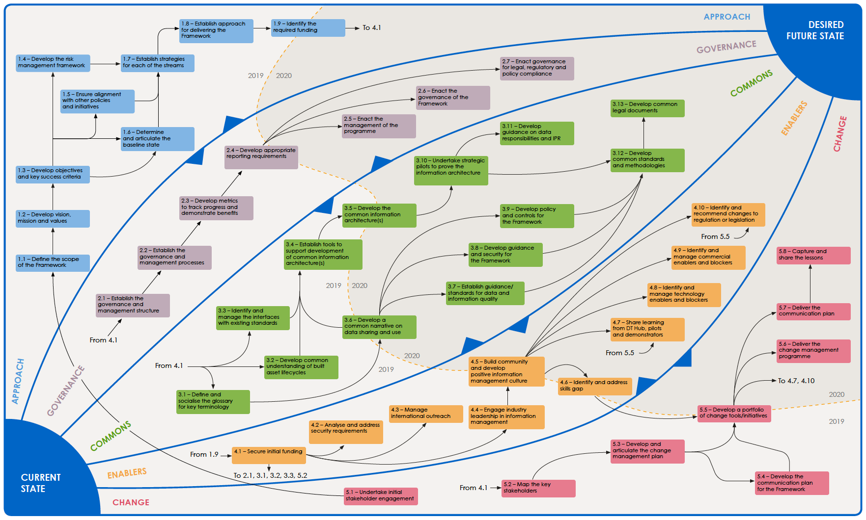
Roadmap for delivering the information management framework for the built environment
Effective information management across the built environment, enabling better decisions, leading to financial savings, improved performance and service, and better outcomes for business and society per whole-life pound.
The right information in the right hands at the right time.
Notes:
Please ensure that you use the latest version of the Roadmap from Sharepoint

Slide 16
The DT Hub
“A collaborative web-based community of those who are making serious progress with digital twins”
Target members:
Asset owners
Cities
Universities

Slide 17
Purpose
To share experience and learning; ideas/innovation and expertise; to identify the “state of the art”
To showcase benefits/ what DTs can achieve
To network, find partners and seek support in addressing challenges
To be a centralised register/database of leading digital twins, pilots and demonstrators
To identify gaps in demonstrating the DTs’ purposes; to define additional pilots
To promote the adoption of the framework
Notes:
Chara note: not sure if we want to present the identify available funding as a purpose

Slide 18
Purpose
To provide a focus for learning and sharing experiences on digital twins. To identify good practice and develop guidance
To drive innovation, develop expertise and advance the “state of the art” for digital twins in the built environment
To showcase the benefits of digital twins; creating case studies that will provide evidence for business cases
To create a support network for seeking partners and finding support in addressing challenges
To provide a register of digital twins within the built environment; showing who is doing what where; identifying gaps and defining the additional pilots to address them
To promote the adoption of the Information Management Framework and to create the basis of the National Digital Twin

Slide 19
Collaborate with CDBB engagement@cdbb.cam.ac.uk www.cdbb.cam.ac.uk @CambridgeCDBB

Slide 20
Appendix

Slide 21
Approach
1.1 Scope definition – Define the scope of the Framework
1.2 Vision and mission – Develop vision, mission and values
1.3 Objectives – Develop the objectives and key success criteria
1.4 Risk management – Develop the risk management framework
1.5 Alignment – Ensure alignment with other policies and initiatives
1.6 Baseline – Determine and articulate the baseline state
1.7 Strategies for each stream – Establish strategies for each of the streams
1.8 Overall approach – Establish the overall approach for delivering the Framework
1.9 Funding requirements – Identify the required funding

Slide 22
Governance
2.1 Governance structure – Establish the governance and management structure
2.2 Governance processes – Establish the governance and management processes
2.3 Metrics – Develop metrics to track progress and demonstrate benefits
2.4 Reporting – Develop appropriate reporting requirements
2.5 Programme management – Enact the management of the programme
2.6 Framework governance – Enact the governance of the Framework
2.7 Legal/policy compliance – Enact the governance for legal, regulatory and policy compliance

Slide 23
The Commons
3.1 Framework glossary – Define and socialise the glossary for key Framework terminology
3.2 Industry process models – Develop common understanding of built asset lifecycles
3.3 Interfaces with related standards – Identify and manage the interfaces with existing standards
3.4 Architecture tools – Establish tools to support development of common information architecture(s)
3.5 Information architecture(s) – Develop the common information architecture(s)
3.6 Data sharing guidance – Develop a common narrative on data sharing and use
3.7 Data quality standards – Establish guidance/standards for data and information quality
3.8 Security and privacy – Develop guidance on security and privacy for the Framework
3.9 Policy and controls framework – Develop and agree the policy and controls framework for the Commons
3.10 Information architecture pilots – Develop and run strategic pilots to prove the information architecture
3.11 Data responsibilities – Develop guidance on data responsibilities and IPR
3.12 Common standards and methodologies – Develop common standards and methodologies
3.13 Common legal documents – Develop common legal documents

Slide 24
Change
5.1 Initial stakeholder engagement – Undertake initial stakeholder engagement
5.2 Stakeholder mapping – Map the key stakeholders
5.3 Change management plan – Develop and articulate the change management plan
5.4 Communication plan – Develop the overall communication plan for the Framework
5.5 Toolbox for change – Develop a portfolio of change tools/initiatives
5.6 Change management delivery – Deliver the change management programme
5.7 Communication plan delivery – Deliver the communication plan
5.8 Feedback – Capture and share the lessons

Slide 25
Enablers
4.1 Funding – Secure initial funding
4.2 Security – Analyse and address security requirements
4.3 International outreach – Manage international outreach
4.4 Leadership – Engage industry leadership in information management
4.5 Culture – Build community and develop positive information management culture
4.6 Skills and training – Identify and address skills gap
4.7 Pilots and demonstrators – Share learning from pilots and demonstrators
4.8 Tools and technology – Identify and manage technology enablers and blockers
4.9 Commercial – Identify and manage commercial enablers and blockers
4.10 Legislation and regulation – Identify and recommend changes to regulation or legislation

