Slide 1
Our
Vision
for the built environment

Slide 2
Who we are

Slide 3
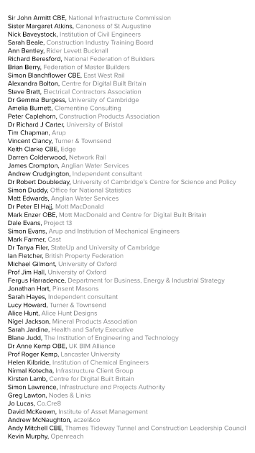
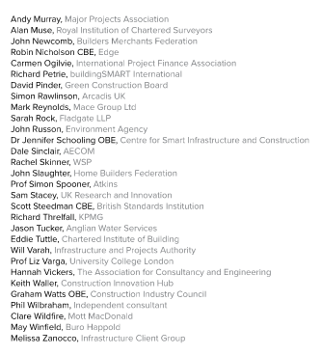
Acknowledgements

Slide 4
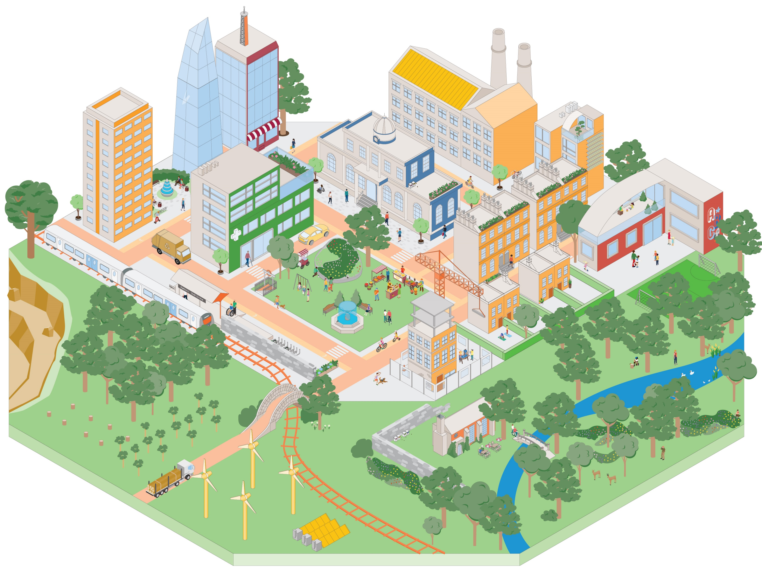
The Vision
Our Vision is for a built environment whose explicit purpose is to enable people and nature to flourish together for generations
It is only when we shift our focus from creating the built environment to the outcomes enabled by it that people and nature can thrive together for the generations to come
The built and natural environments are complex and interconnected systems that are essential for our wellbeing
Improving outcomes for people and nature depends on the services that these systems provide and on coordinating the built environment as a whole, not just as individual parts

Slide 5
Why now
The built environment is too big to ignore
The greatest challenges of our generation are systemic and interdependent
The pandemic has emphasised important realities:
Wellbeing is crucial
Decisions have long-term consequences
Change can happen quickly
We need to get more from less

Slide 6
Why now - Choices in the built environment can last for generations

Slide 7
Improving outcomes – use is at the centre of the built environment

Slide 8
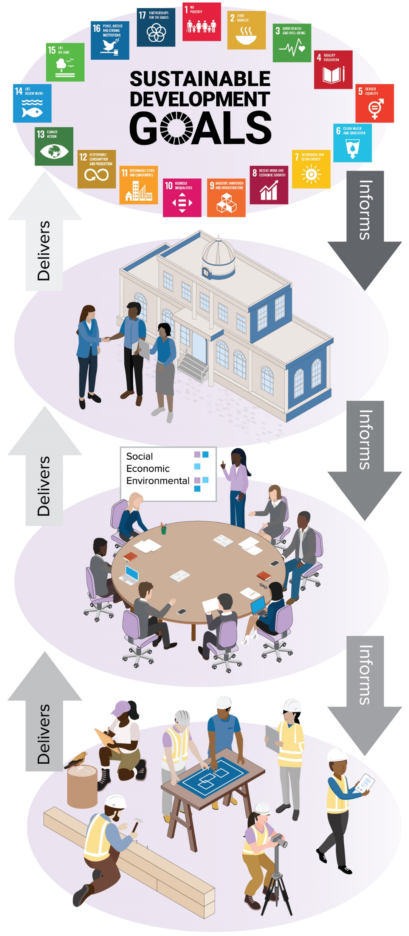
Aligned outcomes

Slide 9
Systems – the ‘system of systems’ working healthily in balance

Slide 10
Services - the connection between the outcomes we desire and the systems we use to achieve them

Slide 11
Enablers
We believe that we can make Our Vision a reality, but only if we all play our part with energy, coordination and purpose, making use of the advanced array of enablers that we now have at our disposal.

Slide 12
Enablers – increasing integration
New skills, capabilities and more collaborative ways of working.
Sharing of processes and information across traditional silos.
Dynamic partnerships between government, industry, academia and the users of the built environment.
Outcome-focused collaborative delivery models.

Slide 13
Enablers – Fourth Industrial Revolution
As the built environment becomes increasingly cyber-physical, we need to improve capabilities and tools to understand and intervene effectively in complex systems:
Capabilities - systems engineering, complexity science, information management and data science.
Tools - internet of things, artificial intelligence, virtual reality, robotics and connected digital twins.

Slide 14
Enablers - driving digitalisation
Digitalisation is fundamentally about enabling people:
to manage information effectively
to improve processes
to apply technology wisely
Effective information management requires the right people to have the right information at the right time to make better decisions, leading to better outcomes.
right information
right time
=
better decisions
better outcomes

Slide 15
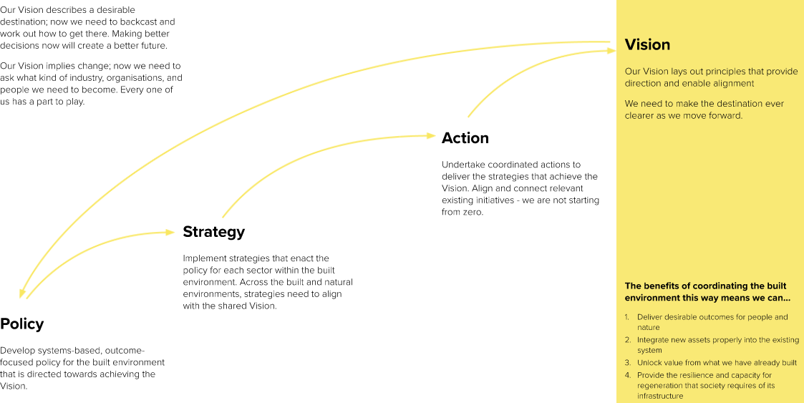
Realising the Vision

